Slide 1
CSCI U511 01 Operating Systems AKM Jahangir A Majumder, PhD
Fall 2019 - Lecture 6
Sept. 10, 2019
Note: Some slides are adapted from those used by previous instructors and some slides include figures from the textbook.

Slide 2
Review and Learning Outcomes
We finished to discuss Chap 2: Kernels and Abstraction
We will start to Chap. 3: The Programming Interface today
Shell
CreateProcess
Process Management
Quiz 1 grades and keys are posted on Blackboard
We will have Quiz 2 on Thursday, September 19, which will cover lectures 4-7
HW 1 key and grades are posted on Blackboard
HW 2 will post on Blackboard soon
We will start to discuss project progress next class

Slide 3
In Lecture Review
We finished our coverage on Chapter 2
We will begin our coverage on Chap 3: The Programming Interface now

Slide 4
Main Points
Creating and managing processes
fork, exec, wait
Performing I/O
open, read, write, close
Communicating between processes
pipe, dup, select, connect
Example: implementing a shell

Slide 5
Shell
A shell is a job control system
Allows programmer to create and manage a set of programs to do some task
Windows, MacOS, Linux all have shells
Example: to compile a C program
cc –c sourcefile1.c
cc –c sourcefile2.c
ln –o program sourcefile1.o sourcefile2.o

Slide 6
Windows CreateProcess
System call to create a new process to run a program. The Kernel needs to:
Create and initialize the process control block (PCB) in the kernel
Create and initialize a new address space
Load the program into the address space
Copy arguments into memory in the address space
Initialize the hardware context to start execution at ``start'’
Inform the scheduler that the new process is ready to run

Slide 7
Windows CreateProcess API (simplified)
// Start the child process
if (!CreateProcess(
NULL, // No module name (use command line)
argv[1], // Command line
NULL, // Process handle not inheritable
NULL, // Thread handle not inheritable
FALSE, // Set handle inheritance to FALSE
0, // No creation flags
NULL, // Use parent's environment block
NULL, // Use parent's starting directory
&si, // Pointer to STARTUPINFO structure
&pi ) // Pointer to PROCESS_INFORMATION structure
)
The first two arguments specify the program and its arguments
The rest concern aspects of the power runtime environment
Notes:
Ok, pretty complex! But its because there are a lot of aspects to a process

Slide 8
UNIX Process Management
UNIX fork – system call to create a copy of the current process, and start it running
No arguments!
UNIX exec – system call to change the program being run by the current process
UNIX wait – system call to wait for a process to finish
UNIX signal – system call to send a notification to another process
Notes:
UNIX splits creating a process into two steps, each of them a lot simpler.

Slide 9
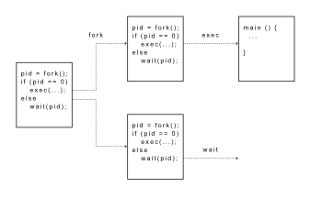
UNIX Process Management
Notes:
How is this used – typically, fork a process, child and parent are now both running the same program. One sets up the child program, and runs exec – becoming the new program
The parent, usually, waits for the child to finish

Slide 10
Question: What does this code print?
int child_pid = fork();
if (child_pid == 0) { // I'm the child process
printf("I am process #%d\n", getpid());
return 0;
} else { // I'm the parent process
printf("I am parent of process #%d\n", child_pid);
return 0;
}
Out 1: Possible I am the parent of process 495 I am process 495 | Out 2: Less likely but possible I am process 456 I am the parent of process 456
Notes:
Parent could print first, or child could print first – you don’t know!

Slide 11
Implementing UNIX fork
Steps to implement UNIX fork
Create and initialize the process control block (PCB) in the kernel
Create a new address space
Initialize the address space with a copy of the entire contents of the address space of the parent
Inherit the execution context of the parent (e.g., any open files)
Inform the scheduler that the new process is ready to run

Slide 12
Implementing UNIX exec
Steps to implement UNIX exec
Load the program into the current address space
Copy arguments into memory in the address space
Initialize the hardware context to start execution at ``start''

Slide 13
UNIX I/O
Uniformity
All operations on all files, devices use the same set of system calls: open, close, read, write
Open before use
Open returns a handle (file descriptor) for use in later calls on the file
Byte-oriented
All devices, even those transfer fixed-size blocks of data, are accessed with byte arrays
Kernel-buffered read/write
Stream data, such as from the network or keyboard, is stored in a kernel buffer and returned to the application on request
Explicit close
To garbage collect the open file descriptor

Slide 14
Interface Design Question
Why not separate syscalls for open/create/exists?
if (!exists(name))
create(name); // can create fail?
fd = open(name); // does the file exist?

Slide 15
UNIX File System Interface
UNIX file open is a Swiss Army knife:
Open the file, return file descriptor
Options:
if file doesn’t exist, return an error
If file doesn’t exist, create file and open it
If file does exist, return an error
If file does exist, open file
If file exists but isn’t empty, nix it then open
If file exists but isn’t empty, return an error
…

Slide 16
Implementing a Shell
char *prog, **args;
int child_pid;
// Read and parse the input a line at a time
while (readAndParseCmdLine(&prog, &args)) {
child_pid = fork(); // create a child process
if (child_pid == 0) {
exec(prog, args); // I'm the child process. Run program
// NOT REACHED
} else {
wait(child_pid); // I'm the parent, wait for child
return 0;
}
}

Slide 17
Where are we?
We finished our coverage on Chapter 3
We will begin our coverage on Chap 4: Concurrency now

Slide 18
Concurrency: Motivation
Operating systems (and application programs) often need to be able to handle multiple things happening at the same time
Process execution, interrupts, background tasks, system maintenance
Humans are not very good at keeping track of multiple things happening simultaneously
Threads are an abstraction to help bridge this gap

Slide 19
Why Concurrency?
Servers
Multiple connections handled simultaneously
Parallel programs
To achieve better performance
Programs with user interfaces
To achieve user responsiveness while doing computation
Network and disk bound programs
To hide network/disk latency

Slide 20
Definitions
A thread is a single execution sequence that represents a separately schedulable task
Single execution sequence: familiar programming model
Separately schedulable: OS can run or suspend a thread at any time
Protection is an orthogonal concept
Can have one or many threads per protection domain

Slide 21
Threads in the Kernel and at User-Level
Multi-threaded kernel
multiple threads, sharing kernel data structures, capable of using privileged instructions
Multiprocess kernel
Multiple single-threaded processes
System calls access shared kernel data structures
Multiple multi-threaded user processes
Each with multiple threads, sharing same data structures, isolated from other user processes

Slide 22
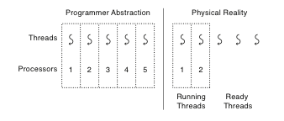
Thread Abstraction
Infinite number of processors
Threads execute with variable speed
Programs must be designed to work with any schedule
Notes:
Execution model: each thread runs on a dedicated virtual processor with unpredictable and variable speed.

Slide 23
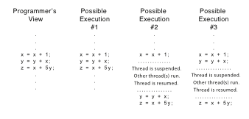
Programmer vs. Processor View
Three possible ways that a thread might execute, all of which are equivalent to the programmer.

Slide 24
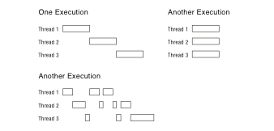
Possible Executions

Slide 25
Thread Operations
thread_create(thread, func, args)
Create a new thread to run func(args)
OS: thread_fork
thread_yield()
Relinquish(give up) processor voluntarily
OS: thread_yield
thread_join(thread)
In parent, wait for forked thread to exit, then return
thread_exit
Quit thread and clean up, wake up joiner if any
OS: thread_exit
Notes:
UNIX fork and thread fork are not the same thing

Slide 26
Example: threadHello
#define NTHREADS 10
thread_t threads[NTHREADS];
main() {
for (i = 0; i < NTHREADS; i++) thread_create(&threads[i], &go, i);
for (i = 0; i < NTHREADS; i++) {
exitValue = thread_join(threads[i]);
printf("Thread %d returned with %ld\n", i, exitValue);
}
printf("Main thread done.\n");
return 0;
}
void go (int n) {
printf("Hello from thread %d\n", n);
thread_exit(100 + n);
// REACHED? Not reached
}

Slide 27
Fork/Join Concurrency
Threads can create children, and wait for their completion
Data only shared before fork/after join
Examples:
Web server: fork a new thread for every new connection
As long as the threads are completely independent
Merge sort
Parallel memory copy

Slide 28
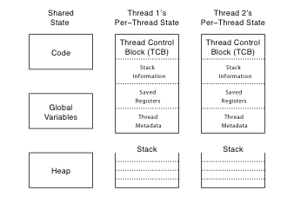
Thread Data Structures

Slide 29
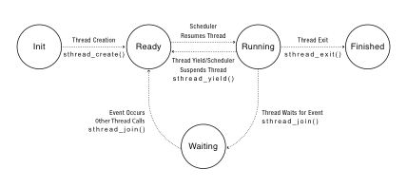
Thread Lifecycle
Notes:
Labels should be thread_create() not sthread_create, etc.

